Slide 1
Improvements Campaign 2011
Supporting operations of Bluffton Family Recreation, Inc.,
a non-profit 501(c)3 organization

Slide 2
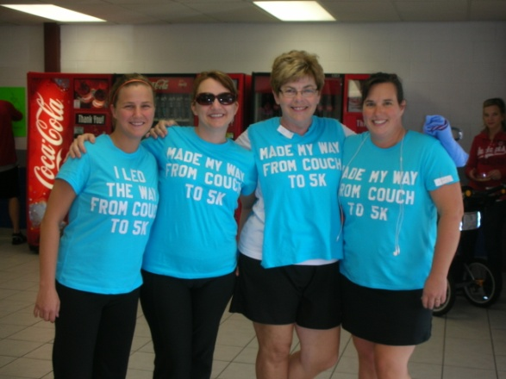
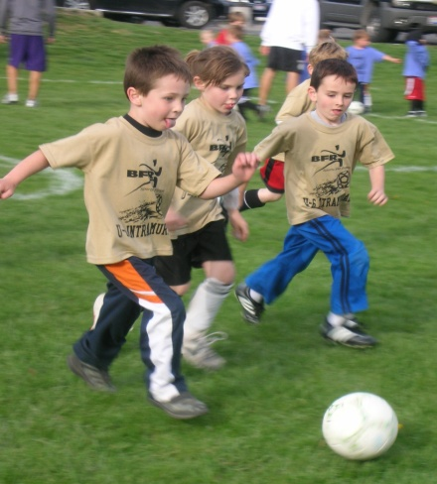
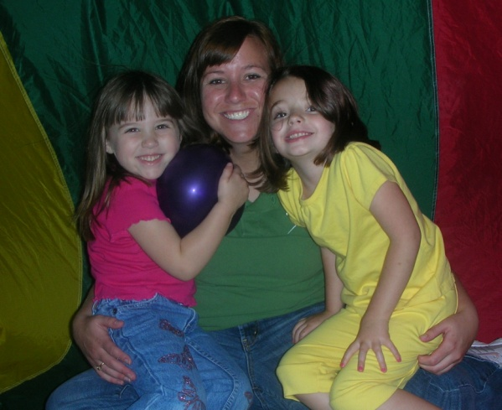
Mission Statement
Bluffton Family Recreation is a non-profit organization dedicated to providing a variety of opportunities and services that encourage learning, fitness, and fun for all ages. We strive to challenge, improve, and develop individual sport skills and team play in a positive and structured atmosphere. We are committed to high quality services and activities in a facility that is safe, self-supporting, and family friendly.

Slide 3
What We Offer…
Fitness Options including Group Classes, Personal Training, and Ultimate Fit are scheduled for daytime and evening hours. Group classes are offered for a variety of ages and fitness levels. Access to the Fitness Center is open to BFR members who are 14 years and older. BFR is a Silver Sneakers partner.
Sport Skill Programs including after-school classes for basketball, dodge ball, football, soccer, swimming, tennis, volleyball are offered through out the school year.
Recreation for Life is offered to all generations! Young children enjoy Tiny Tots, All Sports, Open Play and Family Nights. Youth and adults may participate in drop-in recreation. Recreation Passes and Track Passes are available to individuals and families.
BFR Highlights

Slide 4
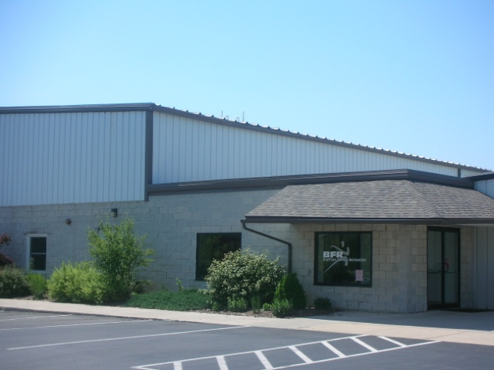
What is the Goal?
Generate $25,000 during 2011
$7,550.00 Fitness Center Improvements (see next slide)
$7,000.00 Lighting Replacements: In conjunction with an AEP rebate program, all lighting in BFR will be replaced with more energy efficient fixtures.
$10,450.00 Roof Repairs: Repairs will be made to fix leaks in the Arena and to repair flashing on the connecting roof. The gym roof will also be checked and repaired as needed.

Slide 5
Fitness Center Improvements
In the past 3 years, three treadmills have been replaced, but no improvements have been made on the strength side. A Cable Cross over has been the most requested item made so is the first choice for addition.

Slide 6
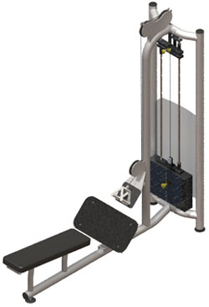
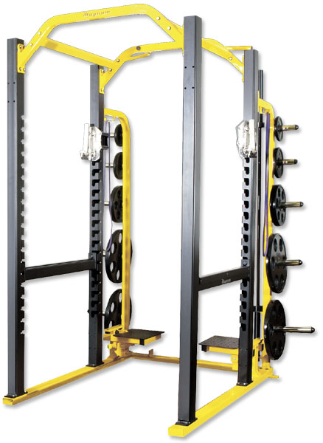
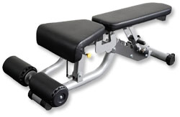
Strength Equipment
FS926 Low Row Stack Weight: 305 lbs. Specific product for building strength in the trunk and latissimus dorsi muscles. Resistance is provided by a weight stack which enables the workload to be adjusted to suit each type of user.
A47 - Super Power Rack -4" x 3" 7 gauge steel uprights are laser cut for easy movement of our heavy duty "J" Hook system. -Featuring flip up spotter stands, adjustable safety bars, dual grip chin bar, Olympic bar storage, band storage, and nickel plated weight storage capable of storing over 1,400 lbs. of rubber Olympic plate.
FS924 - Free Standing Cross Over Weight Stack: 225 lbs each. A crossover cable machine is an exercise machine that consists of two weight stacks separated by a framework of metal, with a space for the exerciser to stand in between the stacks. Chin up bar included.
A86 - Flat / Incline / Decline Bench -Back rest adjusts into seven positions marked in degrees: decline 15 degrees, 0, incline 15, 30, 60, and 80. -Seat adjusts into four positions. -Roller pads stabilize user. -Wheels for ease of movement.

Slide 7
BFR History & Giving
Bluffton Family Recreation was introduced in 1978 as an extension of the Lima YMCA. In 1982 the YMCA declined to continue their partnership, so Bluffton Family Recreation became incorporated as an independent, non-profit organization. Initial programming included youth soccer and basketball leagues, plus adult fitness classes.
After years of discussion, advances were made toward a permanent BFR facility. Land on Snider Road was donated by Ropp and Mary Emma Triplett and Jean Muller in 1993. A two year fund raising drive began and eventually raised over $250,000 toward a facility. The phase I building was opened in the Fall of 1995 with a gymnasium, Fitness Center, locker rooms and office space.
Plans for the Phase II expansion began in 1997 with the intention of adding revenue for the organization. Campaign 21 was held in 1999 to raise funds for the 21,000 square foot expansion including larger fitness center, indoor track, turf arena, playroom, and lobby/office areas. Over $640,000 was raised in the campaign. The first season of indoor soccer leagues began in January of 2000.
The Annual Capital Campaign was introduced in 2004 following a successful fund drive to raise $50,000 for a parking lot and lighting addition. Since that time, Campaign funds have been used to purchase new treadmills for the Fitness Center, to replace air conditioning units, paint bathrooms, and replace the scoreboards in the gymnasium.

Slide 8
Sponsorships & Giving Levels
Pinnacle
(Commit to an Annual Gift of $5,000 or more for 3 years and receive this exclusive package)
Signage (3' x 5') in either the Gym or Arena for 3 years
1 Event Master Sponsorship of a Tournament or Major Program
4 League Sponsorships
Vision Forward
(Commit to an Annual Gift of $2,000- $4,999 for 3 years and receive this exclusive
package)
Signage (3' x 5') in either the Gym or Arena for 3 years
3 League Sponsorships
Gold Star Support
(annual gift of between $1000 - $2,999)
Signage (2' x 3') in either the Gym or Arena renewable annually
1 League Sponsorship
$500 (Event Master Sponsorship Level)
$200 (League Sponsorship Level)
$100 (Program Ad Sponsor)

Slide 9
Thanks for Your Support!
215 Snider Road, Bluffton, OH 45817
www.bfronline.com 419-358-4150
Find us on Facebook /blufftonfamilyrecreation

